Slide 1


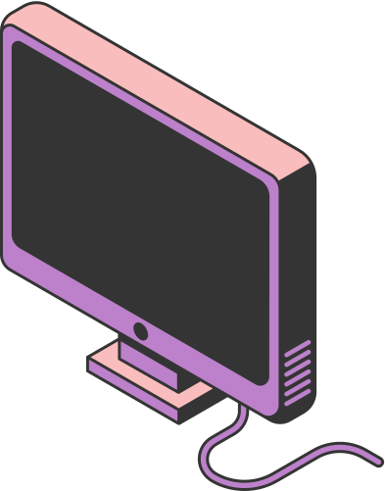
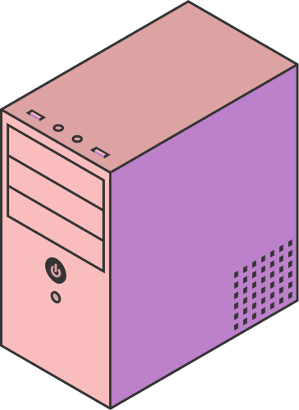
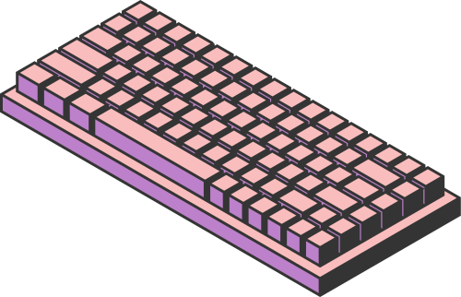
THE HISTORY OF INTERNET
AND INTERNET RULES
Presenter : Aisyah Currents
Student id : 25091397108
Class : International
Study Program - Informatics Management
Faculty of Vocation
Universitas Negeri Surabaya
Page 01

Slide 2
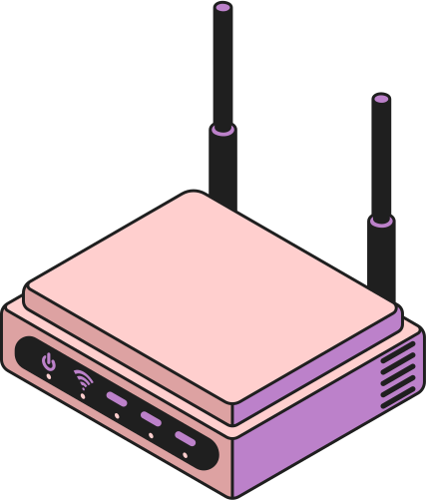
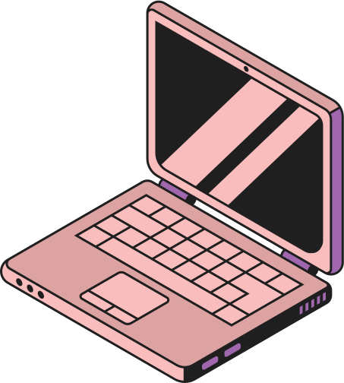
THE EARLY BEGINNING OF THE INTERNET
The internet began in the late 1960s as a U.S. research project called ARPANET(Advanced Research Projects Agency Network), created to connect computers at universities and research centers. Its main goal was to allow information sharing and maintain communication even if parts of the network were disrupted. From these first connections, the system grew into a global network, laying the foundation for the modern internet we use today.
Page 02

Slide 3

THE ROLE OF INTERNATIONAL ORGANIZATIONS IN THE HISTORY OF THE INTERNET
In 1986, the Internet Engineering Task Force (IETF) was formed as an open community of experts and innovators. Their mission was simple yet critical: to develop the technical standards that would allow computers across the world to speak the same language. From this group came many of the core protocols such as TCP/IP, SMTP, and HTTP that still form the backbone of the internet.
In 1998, another milestone arrived with the creation of the Internet Corporation for Assigned Names and Numbers (ICANN). Their role was to manage domain names and IP addresses, ensuring that every website and device on the planet had a unique identity. This was essential for keeping the internet organized as it expanded at an explosive pace.
Together, these milestones highlight a powerful truth: the internet is more than just a technological achievement. It is a product of global cooperation, vision, and shared responsibility. Thanks to these organizations, billions of people today can connect, communicate, and collaborate across one unified digital world.
Page 03

Slide 4
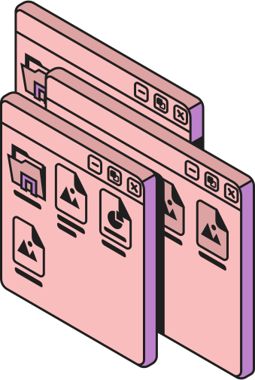
THE INTERNET
ECONOMY
The internet has transformed the way people do business. E-commerce has evolved from small online shops into global marketplaces that connect millions of buyers and sellers. In the financial sector, fintech has revolutionized payments and banking through digital wallets and online services, making transactions faster and more accessible. At the same time, the creator economy has opened new opportunities, allowing individuals to earn from YouTube, podcasts, and digital content. Together, these changes show how the internet has created a new era of global economic growth and opportunity.
Page 04

Slide 5
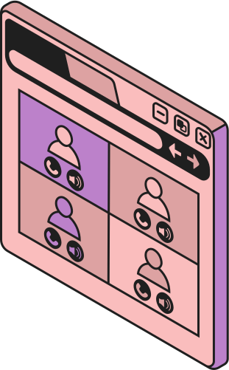
THE INTERNET
RULES
As the internet grows, we also need rules to use it wisely. Online manners, or “netiquette,” mean being polite, respecting other people’s privacy, and avoiding fake news. Internet safety is very important too, such as protecting personal information, using strong passwords, and being careful with scams or viruses. We should also respect copyright by not copying other people’s work and only using content from trusted sources. Finally, the internet should be used in a good way, for studying, working, or connecting with others, while also balancing our time so it does not turn into an unhealthy habit.
We should also respect copyright by not copying other people’s work and only using content from trusted sources. Finally, the internet should be used in a good way, for studying, working, or connecting with others, while also balancing our time so it does not turn into an unhealthy habit.
Page 05

Slide 6
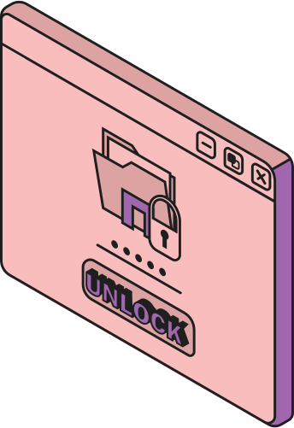
INTERNET
SECURITY
Internet security means protecting yourself, your data, and your devices when you use the internet. It is about keeping information safe from hackers, viruses, scams, and other online threats.
Some key points about internet security are:
1. Protect personal data – Do not share things like your full name, address, phone number, or passwords carelessly.
2. Use strong passwords – A good password should be long, unique, and not easy to guess.
3. Beware of scams and phishing – Be careful with emails, messages, or websites that try to trick you into giving personal information.
4. Use antivirus and updates – Keep your device updated and use security software to block viruses and malware.
5. Safe browsing – Visit trusted websites and avoid clicking on suspicious links.
6. Use secure networks – When possible, connect to safe Wi-Fi and avoid public Wi-Fi for sensitive activities like online banking.
Page 06

Slide 7
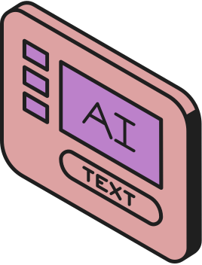
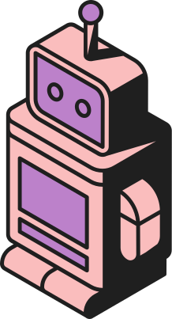
THE FUTURE OF THE INTERNET
Internet of Things (IoT)
The IoT will connect everyday devices such as smart homes, wearable technology, and even self-driving cars. This network of connected devices will make daily life more convenient and efficient by allowing them to communicate and work together.
Artificial Intelligence (AI)
AI will play a central role in shaping the internet of the future. From personalized recommendations to smart virtual assistants, AI will enhance automation and help people and businesses make faster and smarter decisions.
Big Data
With billions of devices online, the amount of data generated will continue to grow. Big Data technologies will analyze this information in real time, supporting breakthroughs in healthcare, education, business, and many other fields.
Quantum Internet
Researchers are working on the development of a quantum internet, which could provide extremely fast speeds and unprecedented levels of security. This technology has the potential to revolutionize the way we communicate and protect information in the future.
Page 07

Slide 8
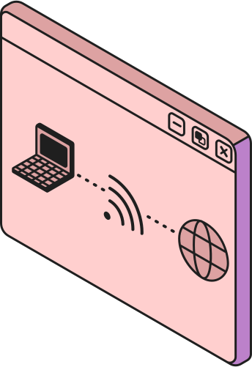
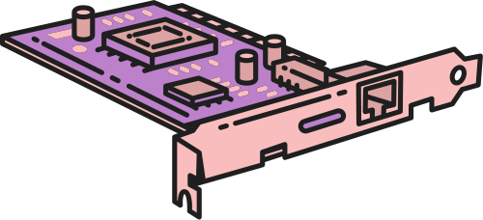
CONCLUSION
In conclusion, the internet has grown from a small research project into a global tool that connects people everywhere. Along with its benefits, it also brings risks, which is why following internet rules and practicing good security are very important. By using the internet politely, protecting personal information, and making responsible choices, we can enjoy its advantages safely while avoiding its dangers.
Page 08

Slide 9
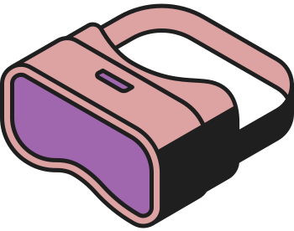


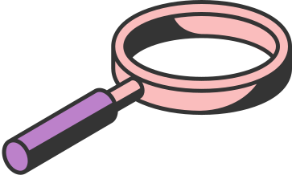
THANK YOU
Page 09

